Slide 1

Traveling the Silk Road: A measurement analysis of a large anonymous online marketplace.
By Nicolas Christin
Economics of Security & Privacy
by Vaishnavi Pawar
LinkedIn: vaishnavipawar09
11/12/2024

Slide 2

Alignment with Course Goals & Skills
Measuring the Costs of Cybercrime:
The Silk Road's economic impact, with revenues of around $1.2 Million per month, highlights
the scale of financial activities in anonymous markets.
E-Crime Infrastructure:
Details how the Silk Road operated as a Tor hidden service, demonstrating the technical
foundation of anonymous e-commerce.
Cryptocurrency and E-crime:
Highlight the role of Bitcoin in supporting anonymous transactions.

Slide 3
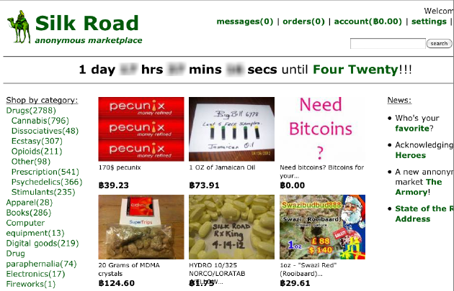
Alignment with Course Goals & Skills
Economic View of Security & Privacy:
The marketplace’s resilience demonstrated the economic benefits of maintaining privacy.
Security & Privacy as Behavioral Economic Phenomena:
Shows how economic incentives drive user adoption despite risks
and legal boundaries.
Risk Perception and Usability:
Users depended on feedback systems to assess seller reliability.

Slide 4
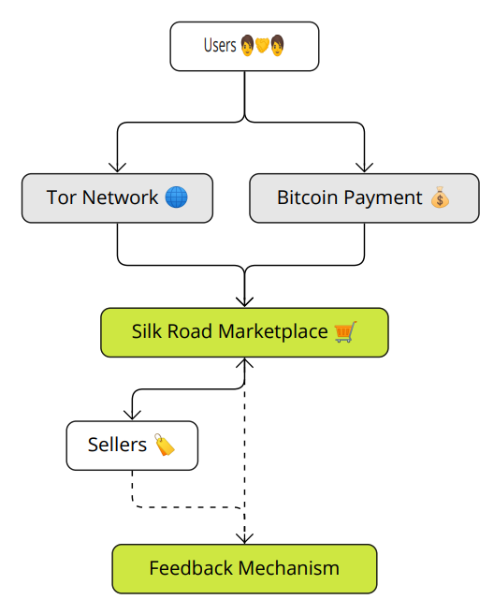
The Topic of This Paper
Big Cosmic Question:
“How does an anonymous online marketplace like the Silk Road function at scale, and what economic and technological factors contribute to its resilience?”
Where It Fits:
This paper addresses open questions about the economics of cybercrime, privacy,
and the role of technology in facilitating illicit trade.
Main Focus of this Paper:
Economic Analysis: How financial incentives influence users and operators.
Technological Infrastructure: Role of Tor and Bitcoin in supporting anonymity.

Slide 5
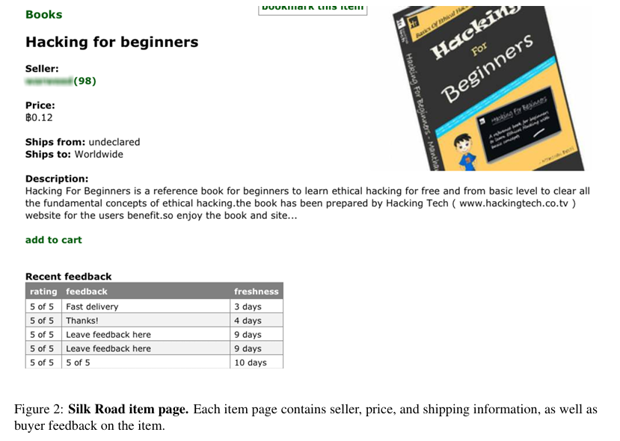
The Topic of This Paper
Spam and E-Crime: Draws parallels to other forms of e-crime with economic motivations.
Case study:
A detailed analysis of the Silk Road from February to July 2012,
showcasing revenue, user behavior, and platform resilience.
User Interaction:
Trust-building mechanisms like feedback &
how they impact user retention.

Slide 6

Research Questions
Smaller Research Question:
What strategies and models enable the Silk Road’s sustained profitability & high transaction volume?
How do anonymity technologies (Tor, Bitcoin) support secure, large-scale e-commerce?
How does feedback build trust and manage risk in anonymous markets?
Why these Questions:
Delve into the Technology, Economics, and trust underlying illegal platforms,
revealing challenges for cybersecurity and law enforcement.
Why this Case Study Matters:
The Silk Road analysis serves as a case study highlighting vulnerabilities in the digital ecosystem and offering insights for combating e-crime.

Slide 7

Lessons Learned
Strategies and Economic Models:
Profitability was sustained through low commission fees, user trust, and a variety of products.
High transaction volumes relied on a stable user base and platform reliability.
Anonymity Technologies:
Tor and Bitcoin ensured anonymity, allowing platform growth without identity breaches.
This created a secure ecosystem for users to repeat transactions.
User Trust and Feedback:
Feedback systems built trust, mimicking legitimate e-commerce.
Positive ratings fostered a community, reducing perceived risks.

Slide 8
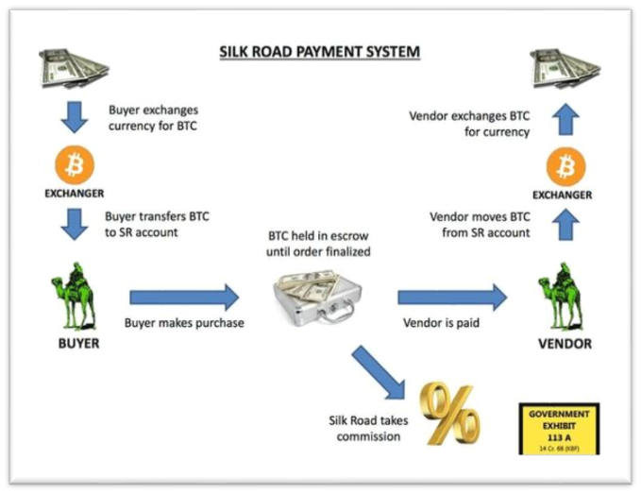
Methodology
Objective: Collect comprehensive data on Silk Road's activity to measure its marketplace characteristics.
Approach: Conducted periodic web crawls of the Silk Road site over six months (Feb 3 to Jul 24, 2012).
Tools: Utilized web crawling tools (e.g., HTTrack) and
anonymized the process using the Tor network.
Supports Main Question:
Effectively uncovers how the Silk Road functioned at scale,
analyzing economic and trust-building mechanisms.

Slide 9
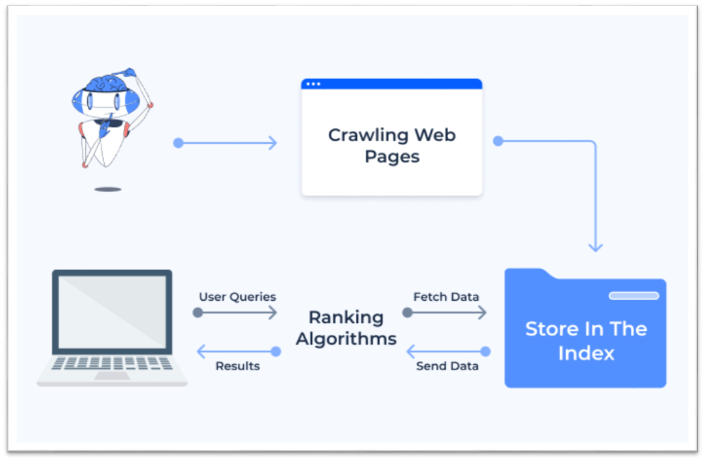
Methodology
Data Collection:
Initial Steps: Registration & Cookies
Web Crawling: Avg 14 hrs./session

Slide 10
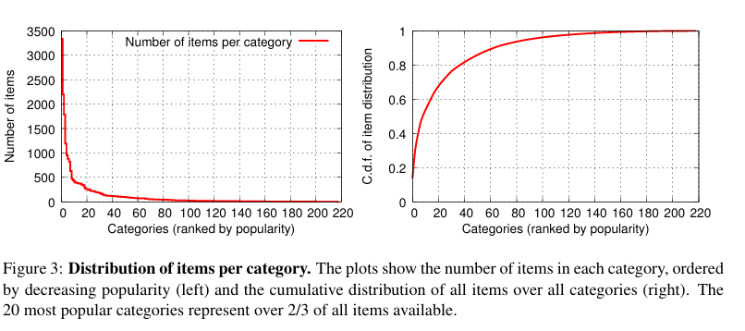
Methodology
Data Analysis Techniques:
Feedback Analysis
Transaction Estimation
Revenue Estimation
Seller and Item Longevity
Trend Observation
Assumptions:
Users rely on Tor & Bitcoin for anonymity.
Feedback ratings were genuine indicators of trust.
Challenges:
Limited by incomplete data during disruptions.
Ensuring accuracy in an anonymous & hidden environment.

Slide 11
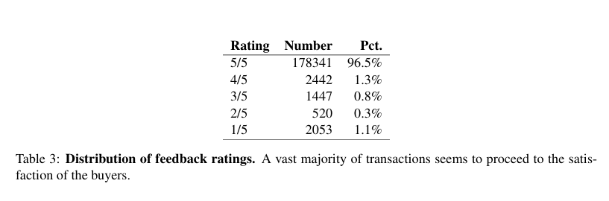

Methodology
Limitations:
Data Gaps: Incomplete data due to disruptions in crawling and platform access.
Feedback Accuracy: Relied on feedback as a proxy for transactions, underestimating true sales.
Anonymity Constraints: Maintain ethical boundaries by only collecting publicly available data through the Tor network.
Technological Challenges: Regularly refreshing authentication cookies and maintaining new Tor circuits to avoid detection.

Slide 12
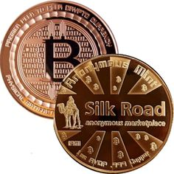
Methodology
Critical Related work:
Nakamoto (2008): Introduced Bitcoin as a peer-to-peer electronic cash system, pivotal for understanding Silk Road's cryptocurrency transactions.
Dingledine et al. (2004): Their work on the Tor network laid the groundwork for examining anonymity technology and how it supports hidden services.
Resnick & Zeckhauser (2002): Studied eBay’s reputation system, highlighting the importance of trust mechanisms that the Silk Road adopted.
Silk Road, Dark Web Marketplace - Former FBI Agent Chris Tarbell
Link: https://youtu.be/oUcSn4t2tsY?si=k7otO_f97znGqpT0

Slide 13

Primarily Research Papers
Findings of the Paper:
Marketplace Scale and Transactions:
The Silk Road generated an estimated $1.2 million per month, illustrating the significant economic impact of anonymous e-commerce.
Trust and Feedback:
The marketplace maintained user trust through a feedback system,
encouraging repeat transactions and fostering community-like interactions.
Anonymity and Technology Use:
Tor and Bitcoin effectively supported user privacy, enabling secure,
large-scale transactions without significant identity breaches.

Slide 14
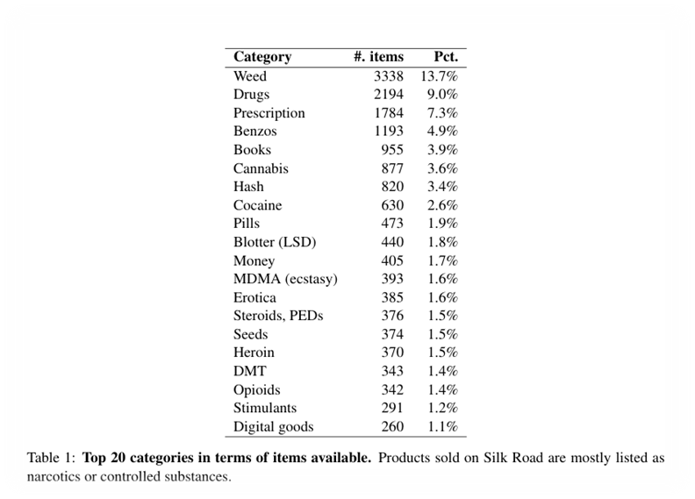
Primarily Research Papers
Revenue and Item Longevity:
Certain categories demonstrated higher revenue and longer shelf life,
indicating stable demand and key profit drivers.
User Engagement:
Items with consistent demand reflected strong buyer trust and
engagement over time, reinforcing the role of trust mechanisms.
Trend Observation:
The sustained popularity of certain items provided insights into
user preferences and marketplace resilience.

Slide 15

Primarily Research Papers
Alternative Explanations:
Market Resilience Due to Niche Demand:
Sustained engagement and profitability may stem from niche demand for unique products, not just anonymity and trust mechanisms.
User Trust Beyond Feedback:
Feedback mechanisms built trust, but familiarity and the dark web’s reputation also boosted user confidence. Trust in anonymity tech likely enhanced perceived safety.
Technological Barriers to Law Enforcement:
Law enforcement's challenges were not solely due to the platform’s strength;
tech and resource limitations of authorities also played a role.

Slide 16
THANK YOU!

